Slide 1
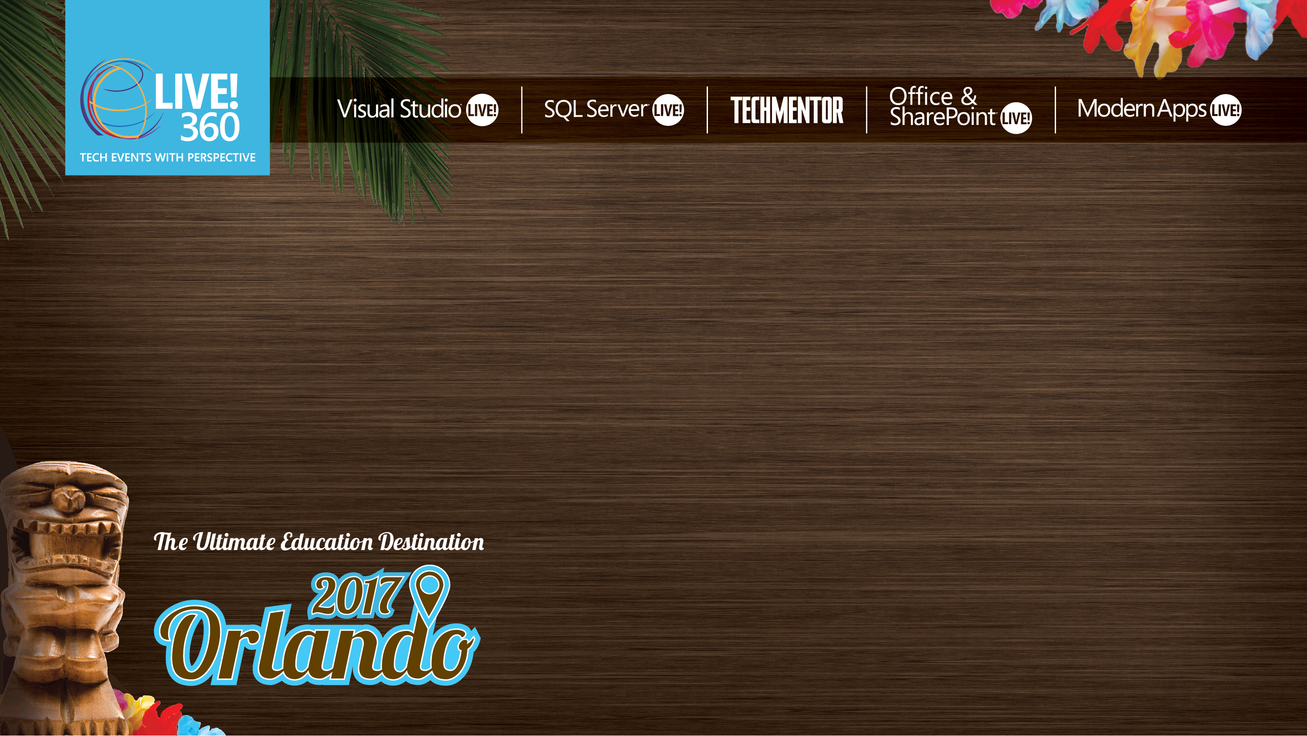
Building Modern Mobile Apps
Universal Windows Platform
Brent Edwards
Principal Lead Consultant
Magenic
Level: Intermediate

Slide 2
Brent Edwards
BrentE@magenic.com
@brentledwards
http://www.brentedwards.net
https://github.com/brentedwards

Slide 3
Mobile Tasks Source Code
Github
https://github.com/brentedwards/MobileTasks

Slide 4
What is UWP?

Slide 5
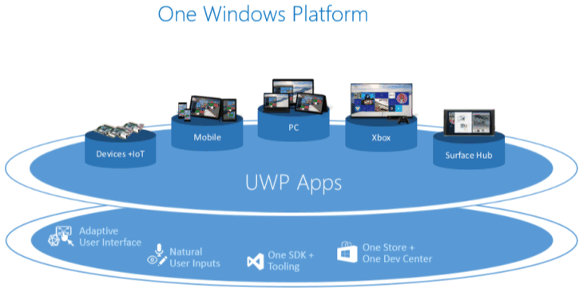
Universal Windows Platform
https://msdn.microsoft.com/en-us/library/windows/apps/dn894631.aspx

Slide 6
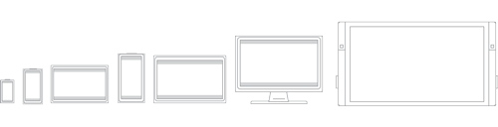
What is UWP?
Build Windows Apps with C# and XAML
https://msdn.microsoft.com/en-us/library/windows/apps/dn894631.aspx

Slide 7
UWP Device Families
Windows 8.1/Windows Phone 8.1 target an OS
Windows 10 provides common app platform
Targets Device Families
One package for all (AppX)
One store for all devices

Slide 8
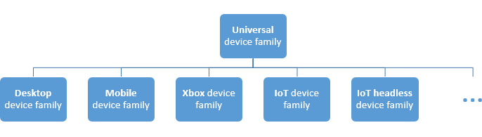
UWP Device Families
https://msdn.microsoft.com/en-us/library/windows/apps/dn894631.aspx

Slide 9
History
C#
Evolved from .NET to WinRT to UWP
XAML
Started with WPF
Evolved with Silverlight, WP, Windows Store

Slide 10
Dev Machine Requirements
Universal Windows
Windows 10 PC
Visual Studio 2015

Slide 11
Testing
Windows Simulator
Dev Machine
Physical Devices

Slide 12
UWP Foundation

Slide 13
Universal Foundation
Layouts
Controls
Styles

Slide 14
Example Controls

Slide 15

RelativePanel
https://msdn.microsoft.com/library/windows/apps/windows.ui.xaml.controls.relativepanel.aspx

Slide 16
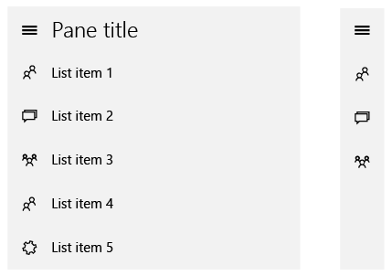
SplitView
https://msdn.microsoft.com/en-us/library/windows/apps/dn997787.aspx

Slide 17
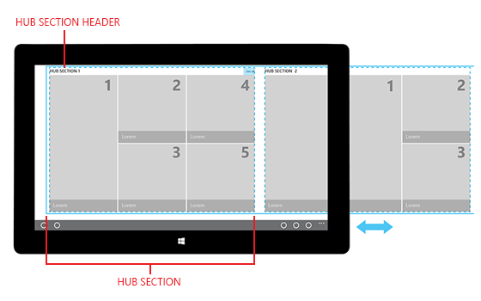
Hub
https://msdn.microsoft.com/en-us/library/windows/apps/dn449149.aspx

Slide 18
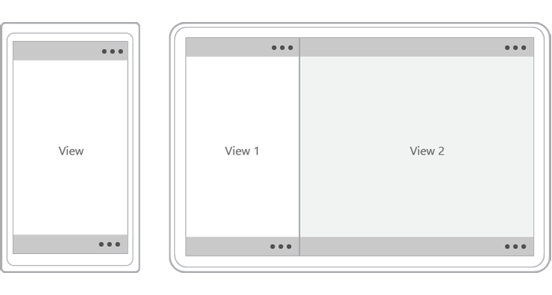
CommandBar
https://msdn.microsoft.com/en-us/library/windows/apps/hh465302.aspx

Slide 19
UI Patterns

Slide 20
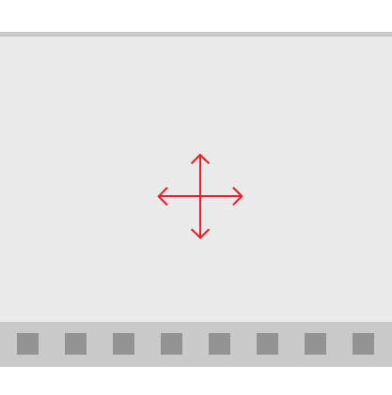
Active Canvas
https://msdn.microsoft.com/en-us/library/windows/apps/dn997761.aspx
Notes:
Content area (above) and Command area (below)

Slide 21
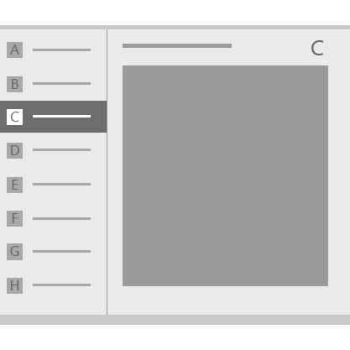
Master/Detail
https://msdn.microsoft.com/en-us/library/windows/apps/dn997765.aspx

Slide 22
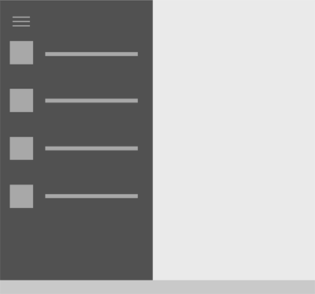
Nav Pane
https://msdn.microsoft.com/en-us/library/windows/apps/dn997766.aspx

Slide 23
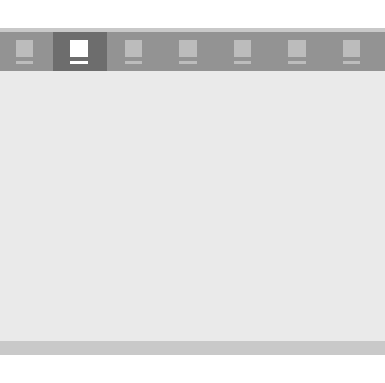
Tabs and Pivots
https://msdn.microsoft.com/en-us/library/windows/apps/dn997788.aspx

Slide 24
Multiple Device Families
Great support for responsive layouts
Lean on
GridView
RelativePanel
StackPanel
Visual States
AdaptiveTrigger

Slide 25
XAML Designer
[DEMO]

Slide 26
Style

Slide 27
Style
Change look-and-feel of controls
Can inherit from existing styles
Two types
Implicit
By Type
Explicit
By Key

Slide 28
Visual States
Another way to change look-and-feel
States can be changed by
Code
Triggers
StateTrigger
AdaptiveTrigger

Slide 29
Style
[DEMO]

Slide 30
Application lifecycle

Slide 31
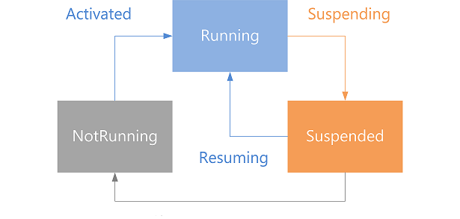
Application Lifecycle
https://msdn.microsoft.com/en-us/windows/uwp/launch-resume/app-lifecycle

Slide 32
Application Lifecycle
Deployment
Launch
Activation
Suspension
Resuming
Closing
Removal

Slide 33
Unit testing

Slide 34
Unit Testing
Create Universal test project
Can run tests locally within Visual Studio

Slide 35
Continuous INtegration

Slide 36
Continuous Integration
Build server needs UWP dev tools installed

Slide 37
deployment

Slide 38
Deployment
Can be done with Visual Studio
Don’t forget to add all assets for icons, etc.
Create App Packages
Choose App Name
Choose Configurations
Test with local Windows App Certification Kit

Slide 39
Thoughts on uwp

Slide 40
Strengths
Working with Visual Studio and C#
Testing is very easy
Cover all Windows device families in one shot

Slide 41
Weaknesses
Windows only

Slide 42
Conclusion
Best choice if building for Windows only
Visual Studio is second to none
Makes the experience very smooth

Slide 43
Questions?

